Slide 1
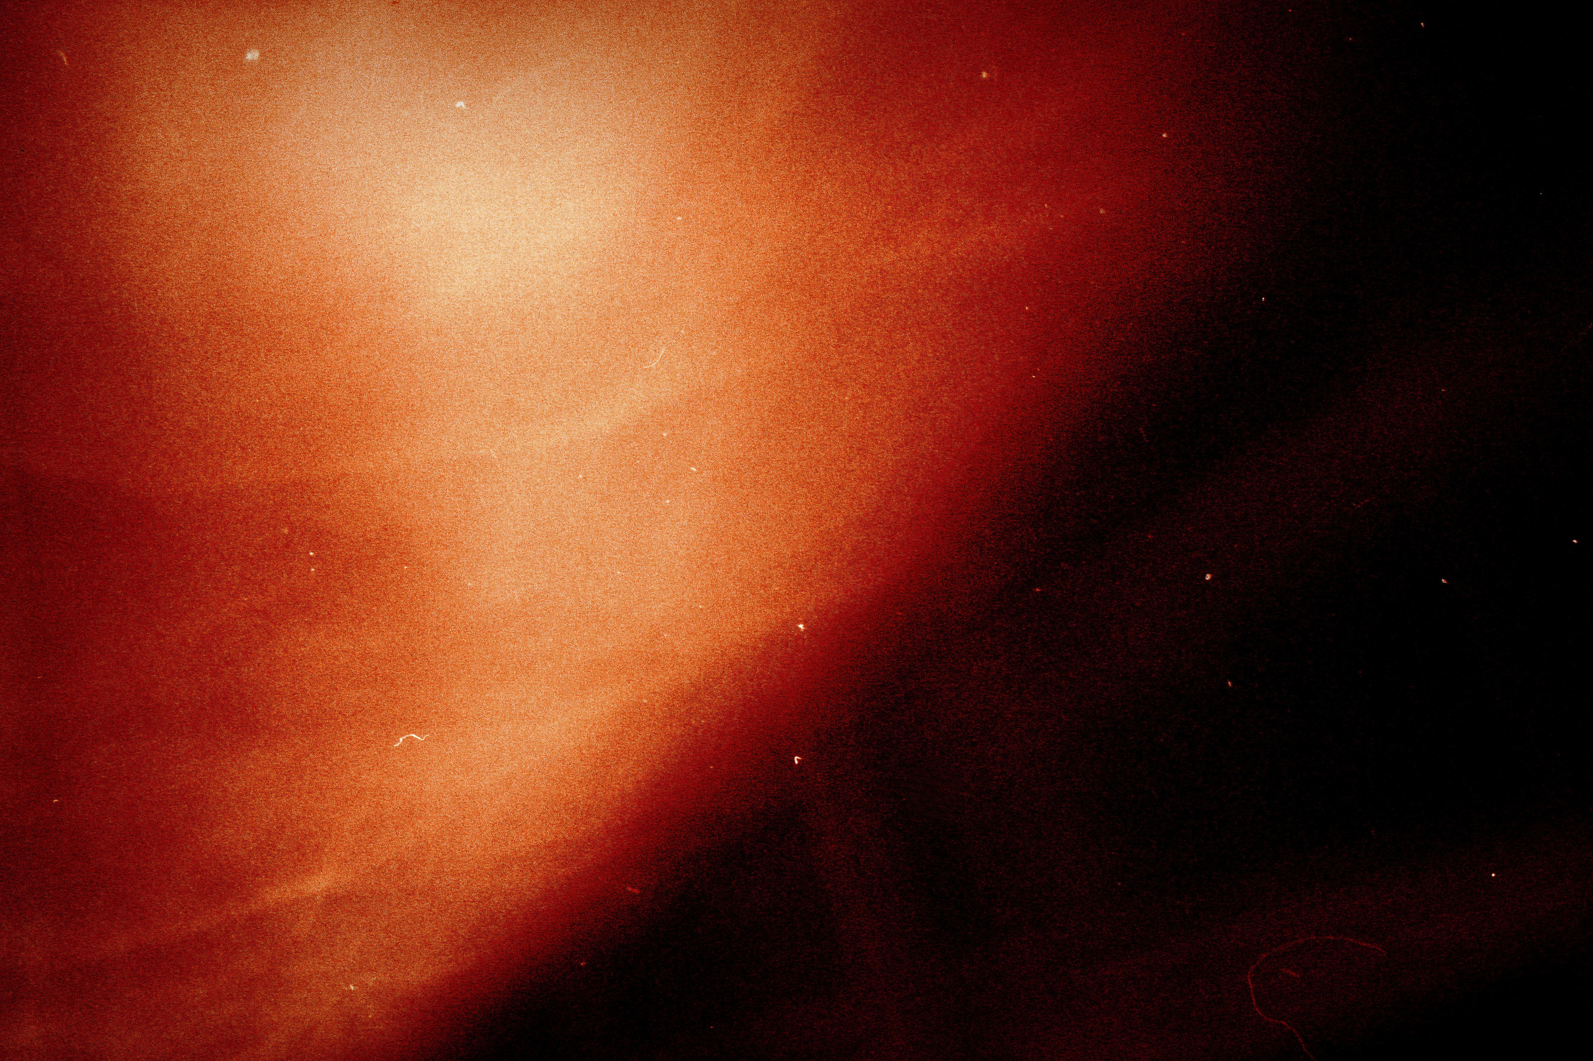

MARCH 2026

Slide 2
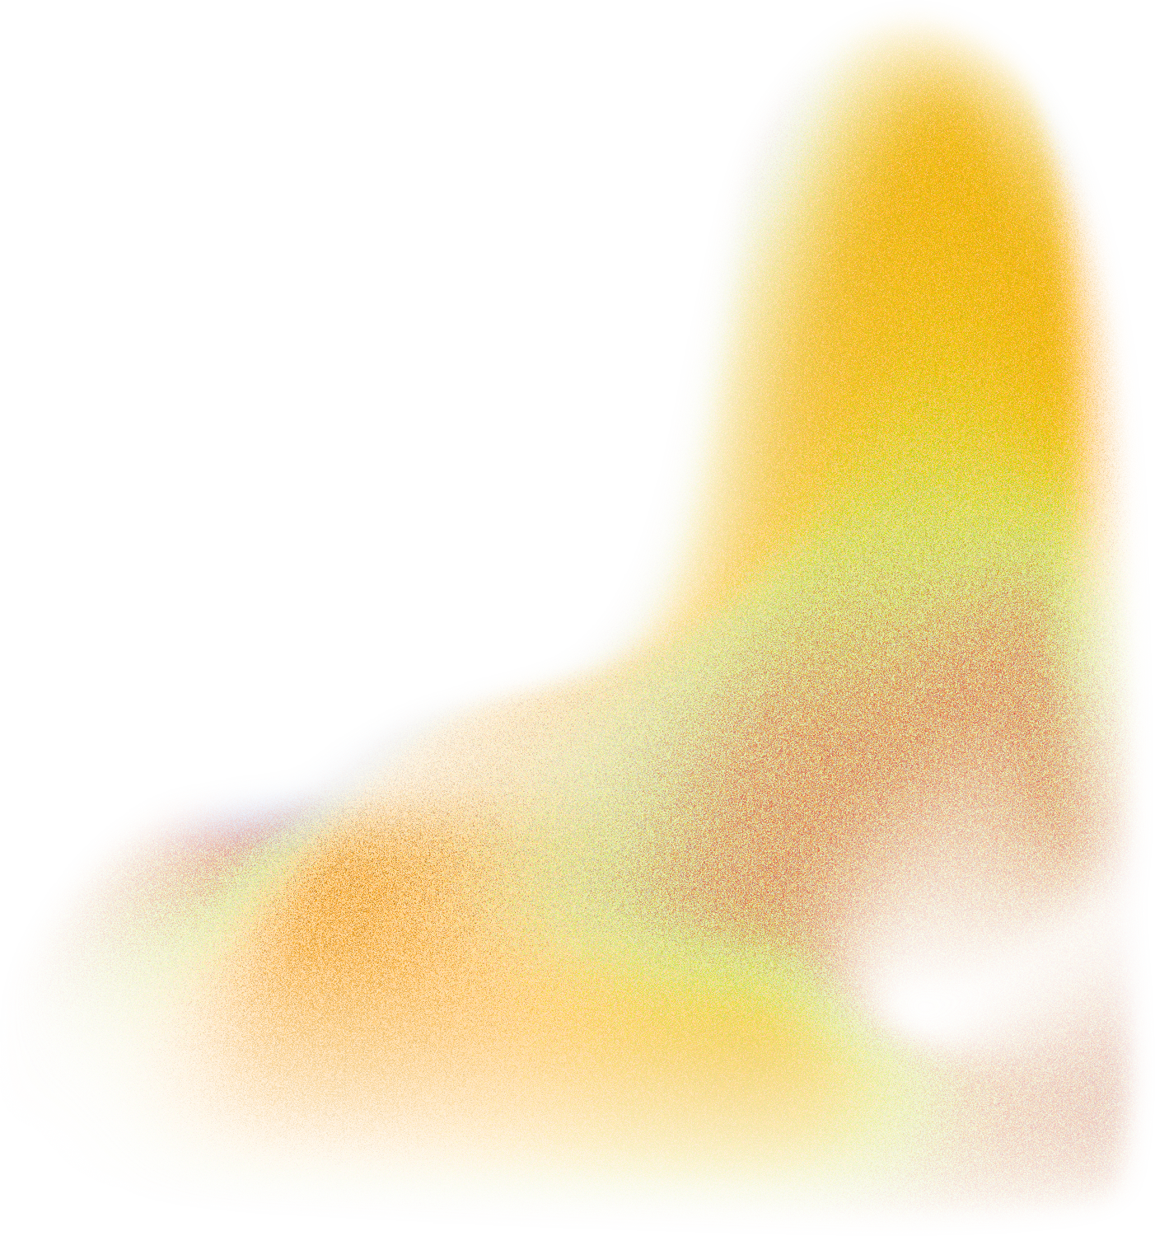
about us
BROUGHT TO LIFE BY POKUAA ADU AND BRIGHT OWUSU-KONADU, ALASA MAGAZINE LENDS ITSELF TO REIMAGINING WHAT TRADITIONAL PRINT MEDIA CAN EVOLVE INTO, THE CONCEPT OF COLLABORATIVE CREATION, AND THE POSSIBILITIES THAT COME FROM REVIVING PAST IDEALS AND QUESTIONING NEW TECHNOLOGY WITH UNCHARACTERISTIC RIGOR.
MARCH 2026
2/5

Slide 3

target audience
TO CONNECT EFFECTIVELY, WE’VE IDENTIFIED AND UNDERSTAND OUR AUDIENCE:
DEMOGRAPHICS: 24-25 YEAR OLD AFRICANS ON THE CONTINENT AND WITHIN THE DIASPORA
PSYCHOGRAPHICS: PEOPLE WHO ARE CONCERNED WITH ART, SUSTAINABILITY, CULTURE & LIFESTYLE CONTENT
MARCH 2026
3/5

Slide 4

rates & pricing
ADVERTISEMENT SIZE | RATES (GHS)
HALF PAGE | 1500
FULL PAGE | 2000
FULL SPREAD | 3000
MARCH 2026
4/5

Slide 5
digital rates
PLACEMENT | RATES (GHS) | DURATION
INSTAGRAM POST | 1500
INSTAGRAM REEL | 2000
INSTAGRAM STORY | 3000
MARCH 2026
4/5

Slide 6

thank you
WWW.ALASA.BIZ
READ@ALASA.BIZ
IG: @READ.ALASA.BIZ
X: @READ_ALASA
MARCH 2026
5/5

